Slide 1
SBA: U.S. Small Business Administration

Slide 2
HOW TO: Home Energy Rebates for small business

Slide 3
Goals of our How To guide
We hope that by the end of this presentation, you will understand:
What the Home Energy Rebates are
Who and what is eligible for the Home Energy Rebates
Why they matter for your small business
Next steps for your small business
How SBA can help your small business be ready to access Home Energy Rebates

Slide 4
Where is the money going?
Inflation Reduction Act Section 50121 ($4.3 billion) and Section 50122 ($4.5 billion)
At least $6.8 billion in rebates for households, contractors, and aggregators
$8.8 billion in Home Energy Rebate funds
$8.3 billion going to States, Territories
$8.5 billion going to States, Territories, Indian Tribes
$218 million going to Indian Tribes*
Up to $1.7 billion for program administration
$264 million for DOE program administration & technical assistance
$264 million for DOE program administration & technical assistance
Funding released in tranches, funding held back only if key requirements not fulfilled
*Tribal program requirements and funding on separate timeline

Slide 5
Home energy rebates and your small business
Rebates
$8.8B in new Home Energy Rebate funds through the Inflation Reduction Act for home electrification or energy efficiency improvement
Your small business
Small businesses will provide the critical installation services for the energy efficiency projects that are eligible for new Home Energy Rebates (e.g., weatherization firms, HVAC and Plumbing companies, Electricians, and other home improvement companies)
Clean energy at a lower cost (and more business for you)

Slide 6
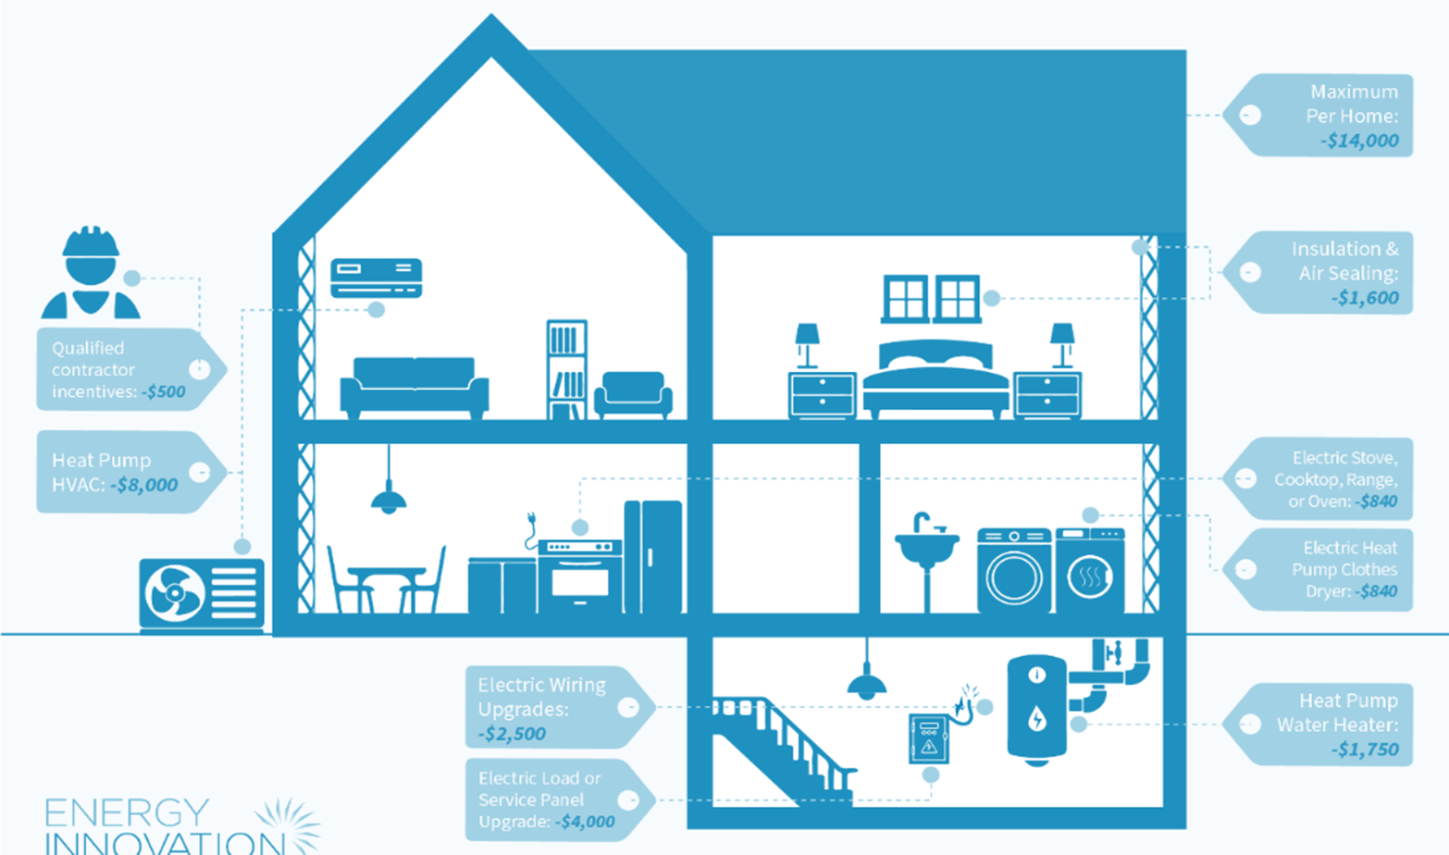
What are the rebates?
Home Efficiency -
$2,000-$8,000 per home dependent on energy savings and income
Home Electrification & Appliances -
Up to $14K per home for qualified equipment

Slide 7
Key details: Home Efficiency Rebate
What projects are eligible
Relevant retrofits may include efficient windows, doors, and insulation materials.
Your state or territorial energy office will determine which products and materials are eligible.
Efficiency projects that produce at least:
20% in predicted energy savings are eligible for rebates of up to $4,000.
35% in predicted energy savings are eligible for rebates of up to $8,000.

Slide 8
Key details: Home Efficiency Rebate
Who is eligible
Households of all incomes are eligible
Lower-income households will get larger rebates.

Slide 9
Key details: Home Electrification and Appliance Rebate
What projects are eligible
Your state, territory, or Tribe will determine which products and materials are eligible from the following:
Up to $8,000 for ENERGY STAR-certified electric heat pump for space heating and cooling
Up to $4,000 for electric load service center (i.e., electrical panel)
Up to $2,500 for electrical wiring
Up to $1,750 for ENERGY STAR-certified electric heat pump water heaters
Up to $1,600 for insulation, air sealing, and mechanical ventilation
Up to $840 for ENERGY STAR-certified electric heat pump clothes dryer
Up to $840 for ENERGY STAR-certified electric stove, cooktop, range, or oven

Slide 10
Key details: Home Electrification and Appliance Rebate
Who is eligible
This rebate is only available to:
low- or moderate-income households
individuals or entities that own a multifamily building with low- or moderate-income households comprising at least 50% of the residents
governmental, commercial, or nonprofit entities that are carrying out projects for low- or moderate-income households or multifamily building owners
Low-income households refer to those earning less than 80% of their area median income (AMI). Moderate income is 80-150% of AMI. Up to 100% of costs will be reimbursed for low-income families and up to 50% for moderate-income families.

Slide 11
What are the next steps for my small business?
Becoming an approved home energy contractor — if your small business:
Is already completing energy efficiency projects, contact your state energy office to become an approved home energy contractor.
Needs training to be business-ready, find the latest information on energy efficiency training in your state.
Learning the details of your state program: Visit DOE’s website and click on your state to link to its energy office.

Slide 12
Let’s walk through an example
Bob has 6 employees and installs HVAC systems in _____ state.
Bob learns about the rebates and wants to take advantage of them.
Bob signs up to receive updates from his state’s energy office website.
Bob receives news that the rebate program is open in his state.
Bob applies to be an approved home efficiency contractor.
Bob is approved.
Bob completes his first project. His customer pays him the amount due minus the rebate.
He uploads proof of completion to his state’s website.
He receives the rebated amount from his state in 90 days, making him whole on the transaction.

Slide 13
When will the resources come online?
Jul-Dec 2023: DOE issued program guidance, technical assistance
documents, and early administrative funding for states to take first steps in developing programs.
Jan 2024: DOE received first state applications for full program funding.
Spring-Summer 2024 (forecasted):Initial programs launch, additional states apply for funding.
Fall 2024-Spring 2025 (forecasted): Final states apply for funding and
remaining programs launch.

Slide 14
How SBA can help
I am worried about the lag time between completing projects and receiving rebates. I need cash on hand to manage my day to day.
Consider asking your local lender about accessing an SBA Express loan to meet your working capital needs.
I need general business counseling and advice as I think about growing my clean energy and energy efficiency services.
Find an SBA District Office or Resource Partner near you for counseling and training.

Slide 15
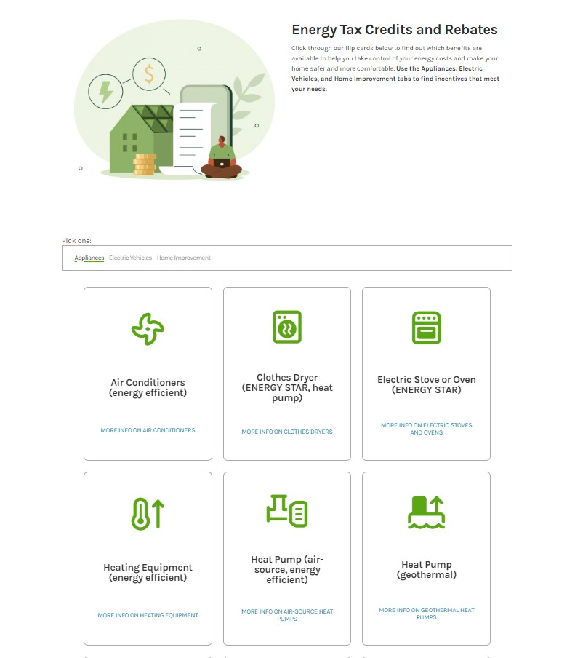
How can I help my customers understand what they are eligible for?
Encourage your customers to visit energy.gov/save to assess potential savings by appliance type and home improvement project type:
Sort by “appliance” or “home improvement”
Click on a tile to learn about savings. Rebates will be noted under “incentive type”

Slide 16
Deep dive on SBA working capital products
SBA Express:
The SBA Express program is a flexible revolving working capital line of credit program that can support needs up to $500,000
Application to approval can be as quick as 1 week
Utilizing an SBA Express line of credit, a contractor can access revolving working capital to purchase equipment and fund the installation expenses on a recurring basis
The loan may enable your small business to take on more clients and grow, knowing that you have access to the working capital necessary to support them along the way.

